Slide 1
App Service, the most loved of services in Azure
Rachel Appel
Microsoft

Slide 2
Let’s say that hosting a cloud-based application is like car ownership…

Slide 3



Let’s say your app is a car…
IaaS
PaaS
SaaS
…you can own and operate your own car
…you can rent a car
…you can take a taxi
Cut to the code - create innovative apps using an application platform
Notes:
[Speaker Guidance: Most of your audience will own a car, and likely be happy with that ownership. This is an analogy to help understand the differences, but don’t try to push the analogy too far. ]
Objective:
Illustrate the differences between IaaS, PaaS and Saas in a simplistic, easy to understand way.
Key talking points:
So what differentiates a developer platform from an infrastructure platform?
It’s pretty simple, there are tiers of responsibility with benefits and tradeoffs between them. For example, to use a car analogy, if you own a car you have to go through the purchase process, buy insurance, maintain and service it over a long period of time, provide parking or garaging (you get the idea).
If you’re renting a car, you get the benefit of a car at your disposal for a fixed time period without any of the overhead of ownership – like maintenance and insurance.
An Uber or a taxi is likely to be the most affordable option, but can have limits on flexibility—you might have to wait five minutes, or maybe stand out in the rain waiting for a ride.
Likewise, building apps on IaaS is a perfectly valid approach. It gives you maximum control and flexibility to run whatever you want—but with added responsibilities.
Conclusion:
If your primary business function isn’t running compute infrastructure, you can get more from your scarce developer time by using an application platform that removes complexity and maintenance responsibility. There might be some trade-off considerations around flexibility, but overall, you can get more done faster and with lower total cost of ownership building on platform as a service (PaaS).

Slide 4


Azure App Service
Web apps
Web apps that scale with your business
Mobile apps
Mobile apps and back-ends for any device
Functions
A serverless event based experience to accelerate your development.
API apps
Easily build and consume APIs in the cloud
Notes:
[

Slide 5
App Service Features & Capabilities
All features and capabilities are shared across all of App Service application (Web, Mobile, and API)
Enterprise grade
Designed for secure mission-critical applications
Fully managed
Optimized for Availability and Automatic scale
Built for DevOps
Agility through Continuous Deployment
Premium Tier
App Service Environments
Hybrid Connections / VPN Support
Scheduled Backup
Azure Active Directory Integration
Site Resiliency, HA, and DR
Web Jobs
Role Base Access Control
Audit / Compliance
Enterprise Migration
Client Certs
Redis Caching
IP Restrictions/ SSL
Web Sockets
SQL, MySQL, DocDB, & Mongo
OS & Framework Patching
Automated Deployment AutoScale
Built-in Load Balancing
WW Datacenter Coverage
End Point Monitoring & Alerts
DR Site Support
WildCard Support
Dedicated IP address
HTTP Compression
WebJobs
Premium WordPress
Sticky Sessions
App Service Environment
Remote Debugging w/ Visual Studio
Site Staging Slots
Traffic Routing
Continuous Integration/Deployment
Git, Visual Studio Online and GitHub
App & Site Diagnostics
Site Extensions Gallery
NET, PHP, Python, Node, Java
Framework Installer
Browser-based editing
Auto-Healing
Logging and Auditing
Admin-Site
Support Site Extension
Notes:
And customers are using some of these features
This is a partial feature list and we are not going to cover each and every feature.
However, I do want to point that we have relapsed 21new public facing features in the past 12 months. at a rate more than 2 features per month….
We plan to continue this pace and even accelerate it to provide more value and innovation to our customers
Hybrid Connections / VPN Support
Scheduled Backup
Azure Active Directory Integration
Site Resiliency, HA, and DR
Web Jobs
Role Base Access Control
Audit / Compliance
Enterprise Migration
Client Certs
Cache
IP Restrictions/ SSL
Web Sockets
SQL, MySQL, DocDB, & Mongo
Sticky Sessions
Authorization/ Authentication
Automated Deployment AutoScale
Built-in Load Balancing
WW Datacenter Coverage
End Point Monitoring & Alerts
App Gallery
DR Site Support
WildCard Support
Dedicated IP address
HTTP Compression
CDN Support for Websites
Premium WordPress
App Services Environments
Remote Debugging with Visual Studio
Site Staging Slots
Testing in Production
Continuous Integration/Deployment
Git, Visual Studio Online and GitHub
App & Site Diagnostics
OS & Framework Patching
Site Extensions Gallery
NET, PHP, Python, Node, Java
Framework Installer
Browser-based editing
Auto-Healing
Logging and Auditing
Admin-Site
Support Site Extension

Slide 6
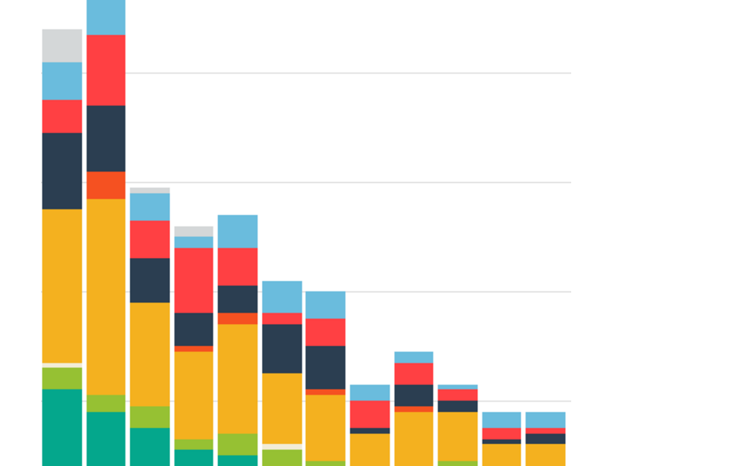

SaaS
Censornet
Objectives
Provide network monitoring to customers. Customers include internationally recognized companies such as McDonald’s.
Tactics
Using App Service Environment to scale across geo-regions and utilize azure functions to process and aggregate data. Azure Functions also used for compiling reporting data.
Results Successfully implemented inter company network monitoring software that can track and log more than 30 million executions world wide per day.

Slide 7
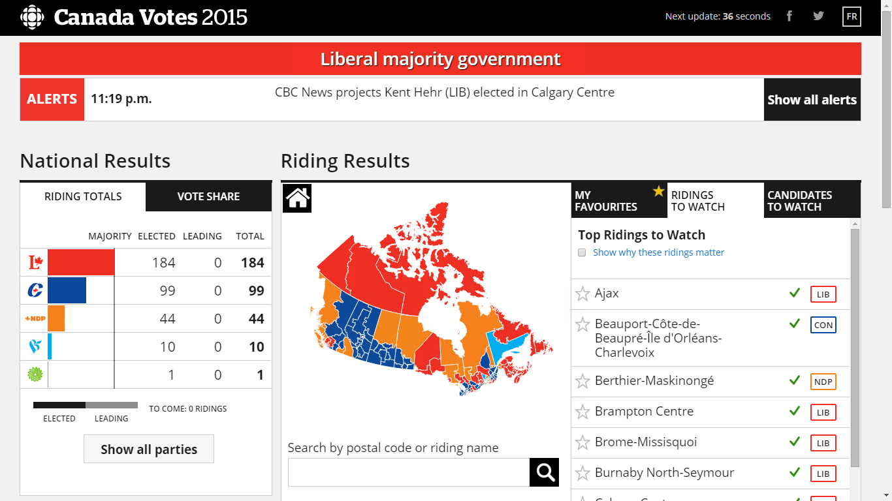
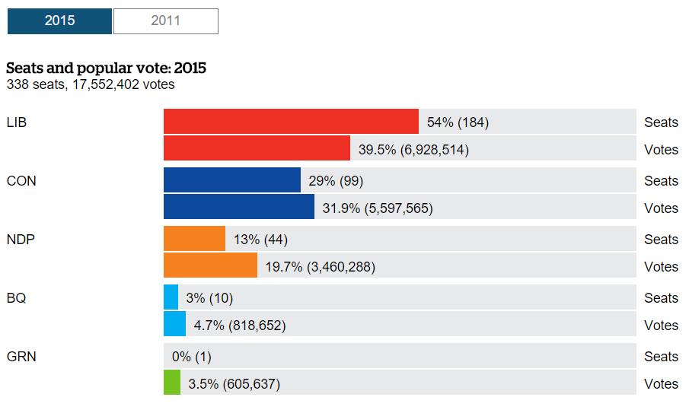
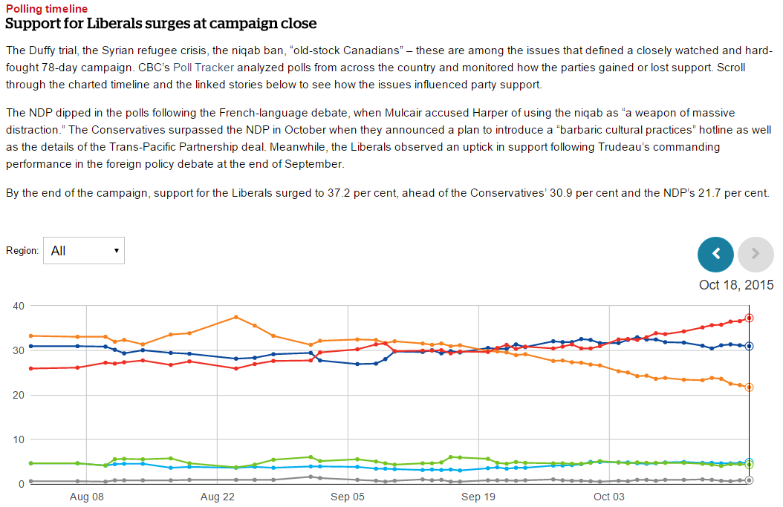
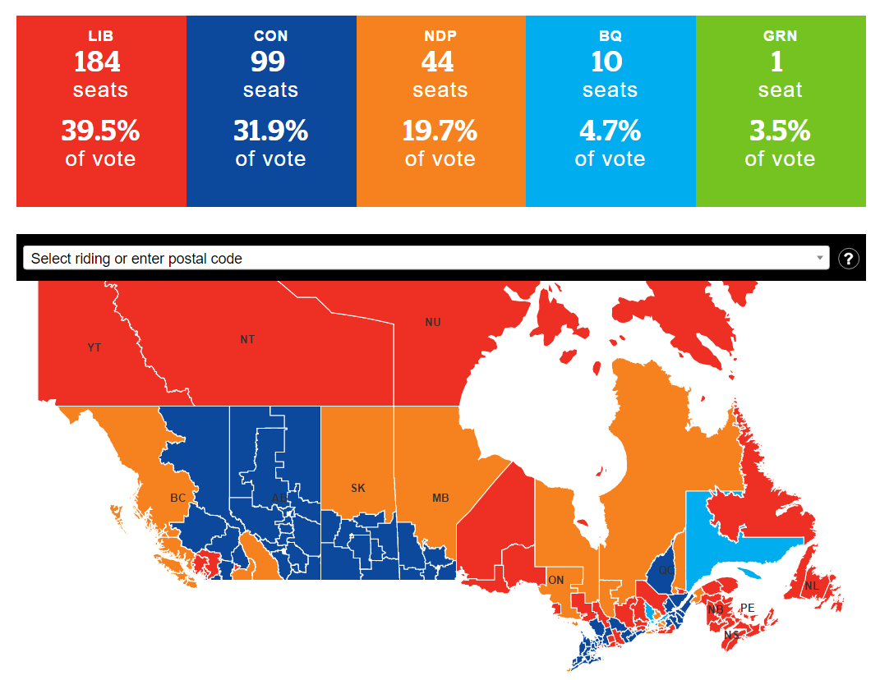
Custom apps
Canadian Broadcasting
Objectives
Provide real-time results of Canadian election at very high scale (nationwide). While keeping the experience for mobile and desktop devices responsive and impressive
Tactics
Using App Service Environment to scale across 3 different geo-regions and utilize (peak time) close to 1,300 cores. Used App Service apps to provide API, web, and mobile experiences
Results
Successfully served 3.6 billion requests over six hours, at a peak of 800k RPS

Slide 8
aka.ms/TryAppService

Slide 9
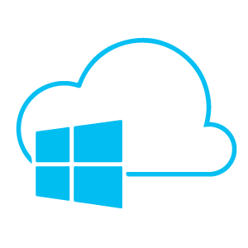
Web App on Linux
Build applications in many languages on Linux and Azure.

Slide 10
Web App on Linux
To build a Web App:
-Resource Group
-Service Plan
-The Web app itself
-Github

Slide 11
Azure Functions
Build serverless applications
with Azure Functions

Slide 12


Azure Functions
Code
Azure Functions
Events + data
Process events with Serverless code.
Make composing Cloud Apps insanely easy
Scale Functions based on customer demand
Develop Functions in C#, Node.js, F#, Python, PHP, Batch and more
Easily schedule event-driven tasks across services
Expose Functions as HTTP API endpoints
Easily integrate with Logic Apps

Slide 13
Demo
Azure Functions

Slide 14
Web App Publishing & Deployment
Publish applications in the cloud

Slide 15
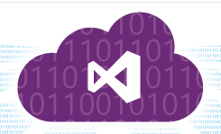
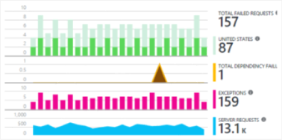


2) Code repository
3) Publish
4) Configure Git
5) Modify
6) Push
………………………… ……….......... ............................ ........... ............ .................. …………………….
Create Repo
Configure Azure
Configure Visual Studio
1) Develop
7) Monitor and improve
Live Web App

Slide 16
Questions?

